Slide 1
Early Indigenous and United States History

Slide 2
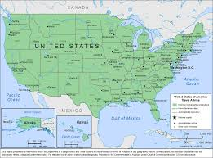
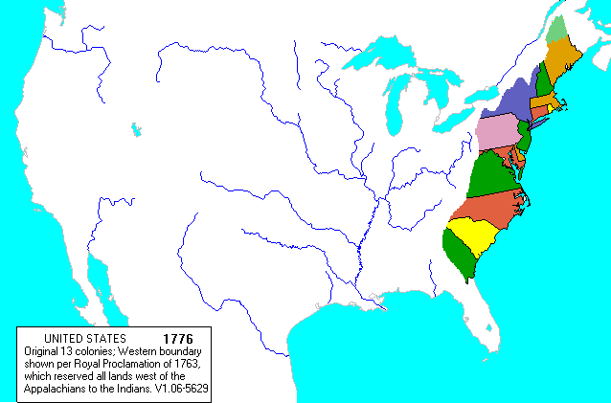
United States Today
United States in 1776

Slide 3
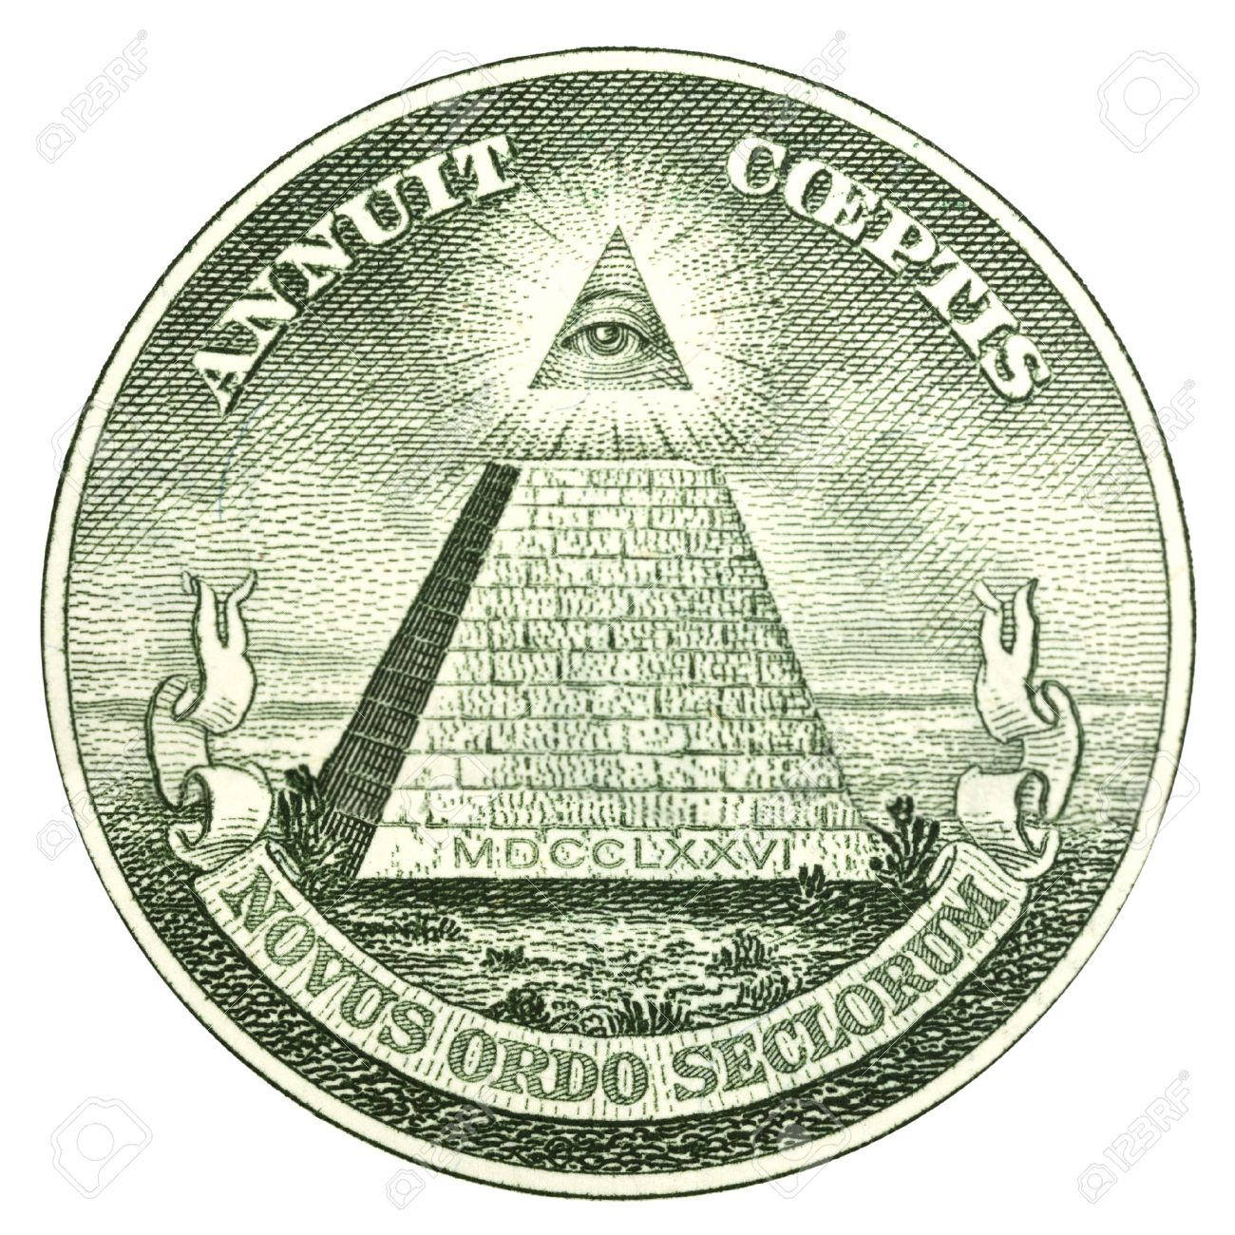
“American Exceptionalism” and “Manifest Destiny”
Mayflower Compact, 1620: “Having undertaken for the Glory of God…a Voyage to plant the first Colony in the northern Parts of Virginia…”
John Winthrop, 1630: “we shall be as a city upon a hill. The eyes of all people are upon us.”
English colonists believed God was aiding them when indigenous people began dying of disease in large numbers.
Symbolism in reverse of the Great Seal (pictured).
“Manifest Destiny” was an idea from the mid-1800s that the U.S. was “destined” to continue conquering and moving further West in part because of an old idea that “Westward the course of empire takes its way.” It served as a justification for war with Mexico that led to the US taking one-third of Mexico’s original territory.

Slide 4
Great Britain’s Settler Colonialism
Settler colonialism: “a form of colonialism which seeks to replace the original population of the colonized territory with a new society of settlers….The land is the key resource in settler colonies.” (Wikipedia article on settler colonialism)
In the early 1600s, Great Britain (aka England) was not as powerful as European competitors (particularly Spain and France) and they worked to increase the size of their empire in the Americas.
England had conquered Ireland in the early 1600s via: 1) “Othering” of an entire people (English argued the Irish were racially inferior); 2) Opening up a huge amount of land for settlement; 3) Intense violence including beheading/scalping Irish people. These practices of settler colonialism continued when the British came to the Americas.
Many of the settlers in conquered Ireland were Scottish people who became known as “Scots-Irish.” Often poor and disadvantaged in the British empire themselves, Scots-Irish often became soldiers in Britain’s conquest of the Irish. Between 1717-1775 over 200,000 Scots-Irish settlers arrived in what soon became the United States, where many continued a tradition of violent settler colonialism they had first learned in Ireland. Millions of Americans are at least partially of Scots-Irish heritage, including 17 presidents.

Slide 5
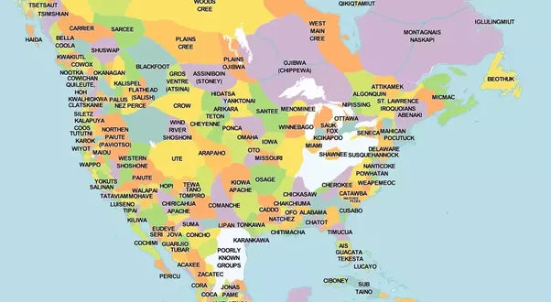
Native Tribes Before European Colonization
Between 7-18 million people lived on the land that eventually became the United States when European colonists first arrived.
Native people in the Americas considered their tribes sovereign nations and practiced a variety of forms of government, often based on consensus decision making.
While some indigenous peoples were primarily hunter/gatherers, many others grew crops and changed the land—clearing forests, using irrigation, etc.—as needed.
These complex societies were linked together through trails and roads that often became the basis for modern-day roads (for example Broadway in Manhattan, which was once the Wickquasgeck Trail).

Slide 6
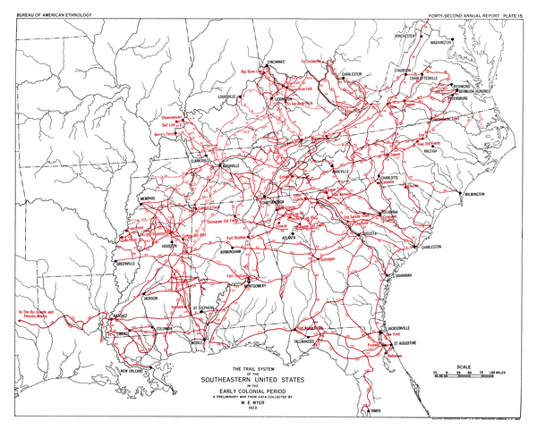
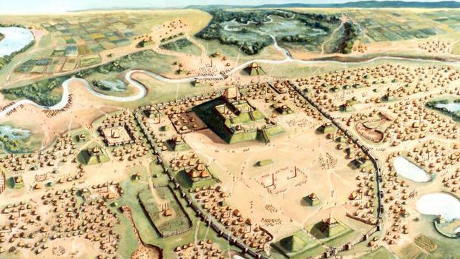
Native Roads and Cities
Indigenous Trails of the Southeast
Cahokia, circa A.D. 1100

Slide 7
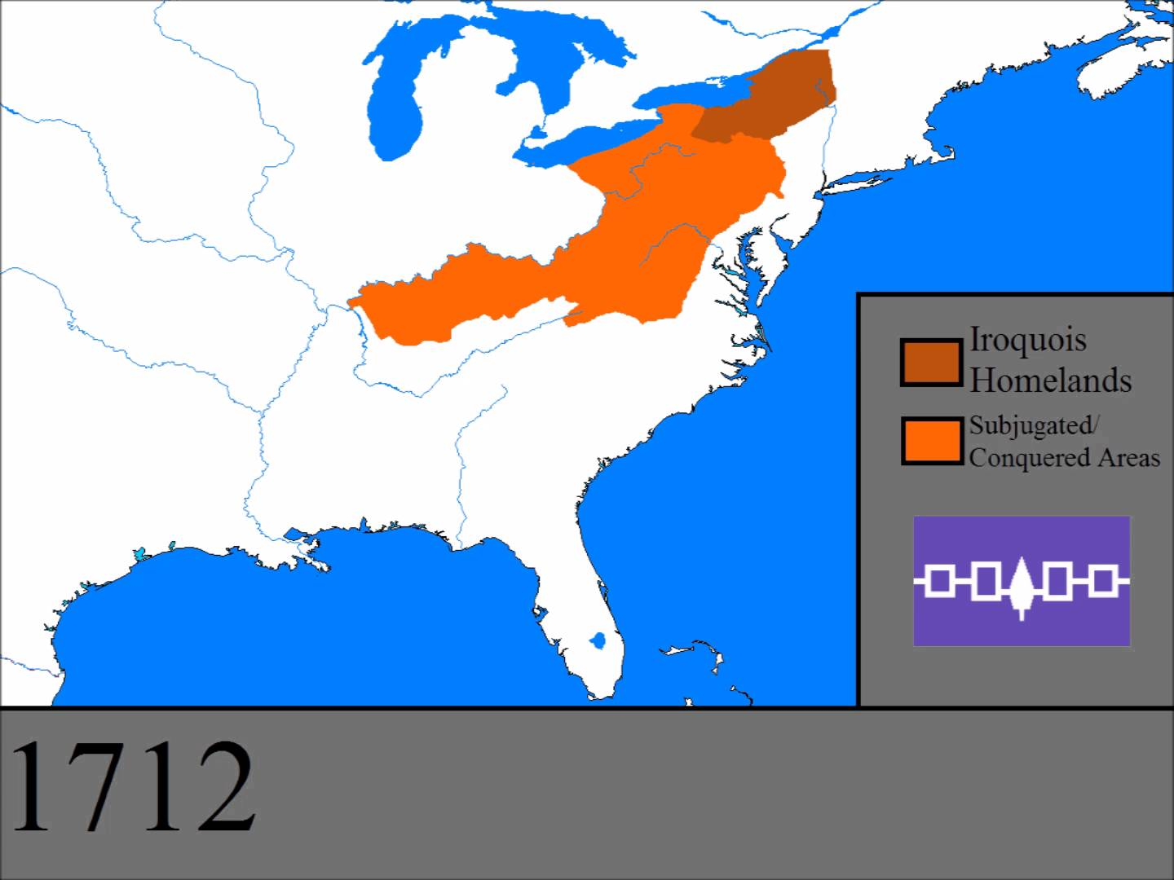
Iroquois Confederation
Usually referred to as the Iroquois, but self-identified as Haudenosaunee.
Began as a confederation of five tribes: Mohawk, Onondaga, Oneida, Cayuga, and Seneca (Tuscarora joined in 1722).
Their homelands were largely in what is now upstate New York, but like the English they were conquerors and militarily powerful so their influence spread far beyond that.
The governmental basis for Iroquois society was an oral constitution known as the Great Law of Peace that was in place well before Columbus arrived in 1492.
Iroquois Confederation was “…probably the greatest indigenous polity north of the Rio Grande in the two centuries before Columbus and definitely the greatest in the two centuries after.” (Charles Mann, 1491)

